Slide 1

Project Seminar
on
Learning COVID-19 pneumonia severity on a large chest X-ray dataset
Presented
by
B MANASA VAMSI(620110)
K MANI KEERTHANA(620149)
M PRAVEEN (620214)
N SATYA(620218)
G YAMUNA(620140)
Supervisor
Dr. John Bob
DEPARTMENT OF E.C.E
NATIONAL INSTITUTE OF TECHNOLOGY ANDHRA PRADESH

Slide 2
Contents :
Introduction
Objectives
Libraries & Methodology
Terminology
Results & Discussion
Conclusion
References

Slide 3
INTRODUCTION :
The COVID-19 pandemic has put significant strain on healthcare systems worldwide.
Chest X-rays (CXRs) provide a noninvasive tool to monitor the progression of COVID-19 pneumonia.
AI-assisted imaging analysis has been used to screen COVID-19 cases and improve triaging of patients.
Practically deployable CXR-based predictive models for COVID-19 pneumonia severity are lacking.
A machine learning project aims to classify the severity of COVID-19 pneumonia based on CXR images.
Early detection and proper management of COVID-19 pneumonia can improve patient outcomes and reduce mortality rates.
Convolutional neural networks (CNNs) are used to learn features that differentiate between different levels of pneumonia severity.

Slide 4
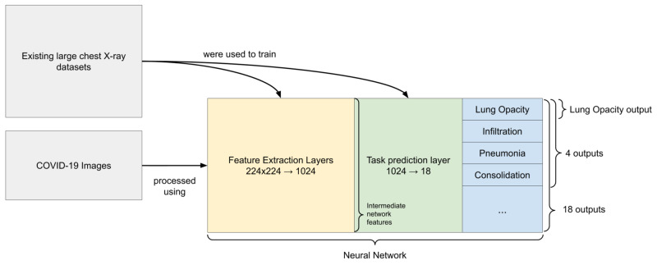
The machine learning models are trained on a subset of the dataset and evaluated on a separate validation set to determine their accuracy and performance.
The project aims to design an end-to-end deep learning architecture for predicting a multi-regional score conveying the degree of lung compromise in COVID-19 patients using CXRs.
The semi-quantitative scoring system, known as the Brixia score, has significant prognostic value in serial monitoring of COVID-19 patients.

Slide 5
Objectives:
Build a machine learning model that predicts COVID-19 pneumonia severity using chest X-ray images.
Improve early detection and proper management of COVID-19 pneumonia to reduce mortality rates.
Evaluate the accuracy and performance of the model on a separate validation set.
Provide a CXR-based predictive model for COVID-19 pneumonia severity, which can optimize patient care and resource allocation.
Contribute to the development of AI-assisted tools for screening and triaging COVID-19 cases.

Slide 6
Libraries :
NumPy
Matplotlib
Seaborn
TensorFlow
Methodology :
The project was carried out in various phases,
1.Data Collection
2.Data Pre-processing
3.Model Development
4.Model Evaluation
5.Deployment

Slide 7
1.Data Collection : JSRT Database , Small tuberculosis dataset from Shenzhen and Montgomery.
2.Data Pre-processing : This step involves cleaning and preparing the dataset for model training. Including removing noise and artifacts, enhancing contrast and sharpness, and resizing the images to a standard size.
3.Model Development : A convolutional neural network (CNN) is used to learn features that can differentiate between different levels of pneumonia severity in CXR images.
4.Model Evaluation : This is done to ensure that the model can generalize well to new, unseen data, and to identify any areas of the model that may need improvement.
5.Deployment : This phase involves making the model available for use in a practical setting, such as a hospital or clinic.

Slide 8
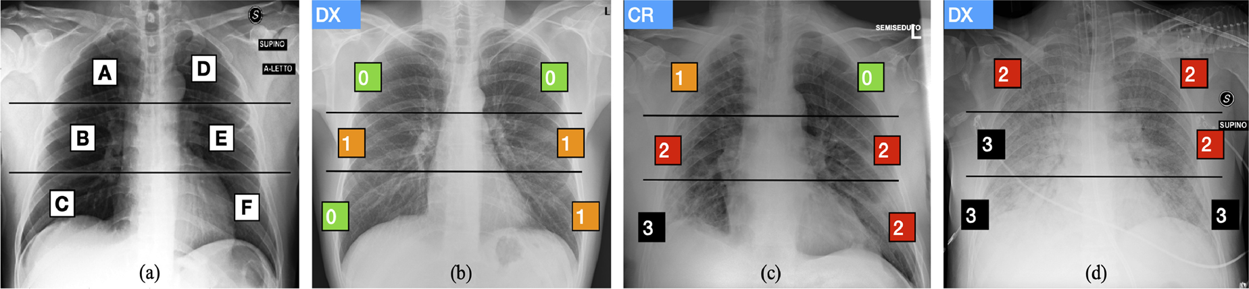
Terminology:
Brixia score: ----- Scoring systems for severity assessment
According to it, lungs in antero-posterior (AP) or postero-anterior (PA) views, are subdivided into six zones, three for each lung.score 0 (no lung abnormalities)
1. (interstitial infiltrates)
2 .(interstitial and alveolar infiltrates, interstitial dominant)
3. (interstitial and alveolar infiltrates, alveolar dominant)

Slide 9
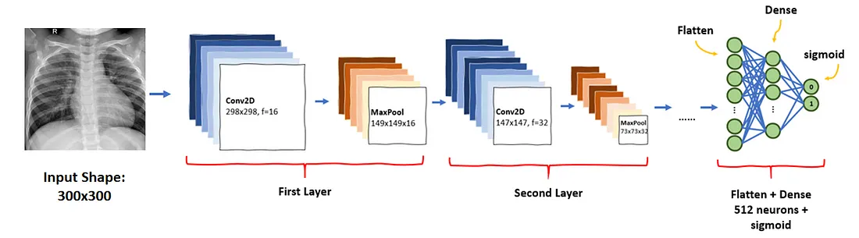
Image segmentation:
This is the process of dividing the given visual data into segments for segment-specific processing to take place . In this project, it is used so that we divide the x-ray given to us will be divided into specific levels as shown in brixia level category to identify the infection.When the whole processing of individual parts is done, we take up a task of clustering all these divided parts of the X-ray and giving it a particular brixia score.
Pneumonia classification using CNN:
Pneumonia classification using Convolutional Neural Networks (CNNs) is a common application of deep learning in medical image analysis. CNNs are a type of neural network that are particularly effective at detecting patterns in images, making them well-suited for tasks such as identifying pneumonia from chest X-rays.

Slide 10
We use CNN for the use of convolutional layers.
These layers perform a series of mathematical operations on small areas of an input image, called filters or kernels, to extract relevant features.
The output of the convolutional layers is then passed through pooling layers to reduce the spatial size of the feature maps while retaining the most relevant information.
Finally, the fully connected layers at the end of the network use these extracted features to make predictions about the input image.
Dataset division:
The given X-ray data is to be divided into the following categories:
1. Segmentation Dataset
2. Alignment Dataset
3. Brixia COVID-19 dataset

Slide 11
Segmentation Dataset:
This phase involves merging datasets containing COVID-19 and normal people X-ray images. The data is then divided into train and test sets. In this phase, image segmentation techniques are used to extract the region of interest (ROI), which in this case is the lung area. This process helps in removing unwanted regions and reduces the complexity of the AI pipeline.
Alignment Dataset:
CXRs acquired in a clinical setting lack standardized levels of magnification and alignment of lungs. In this phase, an alignment block is integrated into the network to avoid including anatomical parts not belonging to the lungs in the AI pipeline.
Brixia COVID-19 dataset:
In this phase, a large dataset of CXR images is collected corresponding to the entire amount of images taken for both triage and patient monitoring. All image reports include the Brixia score, which is a string of six digits indicating the scores assigned to each region.

Slide 12
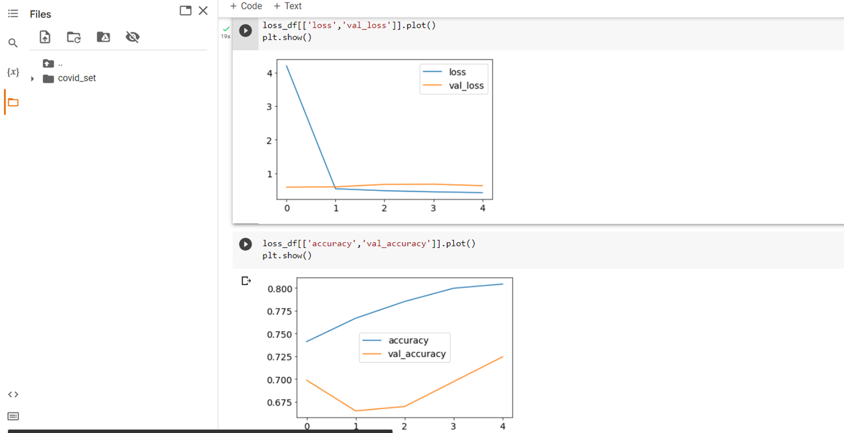
Results & Discussion :
Dataset-1:
1. Loss function is almost same for the train and test datasets.
2. Accuracy is at large difference for the train and datasets(ERROR)

Slide 13
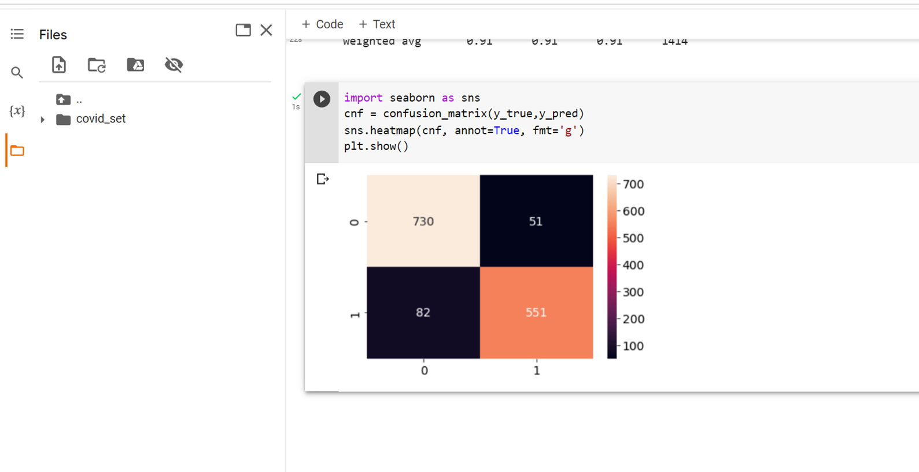
For the dataset_1 ,we implemented a confusion matrix to show the number of correct representation of the images of covid and normal x-rays done by our model.

Slide 14
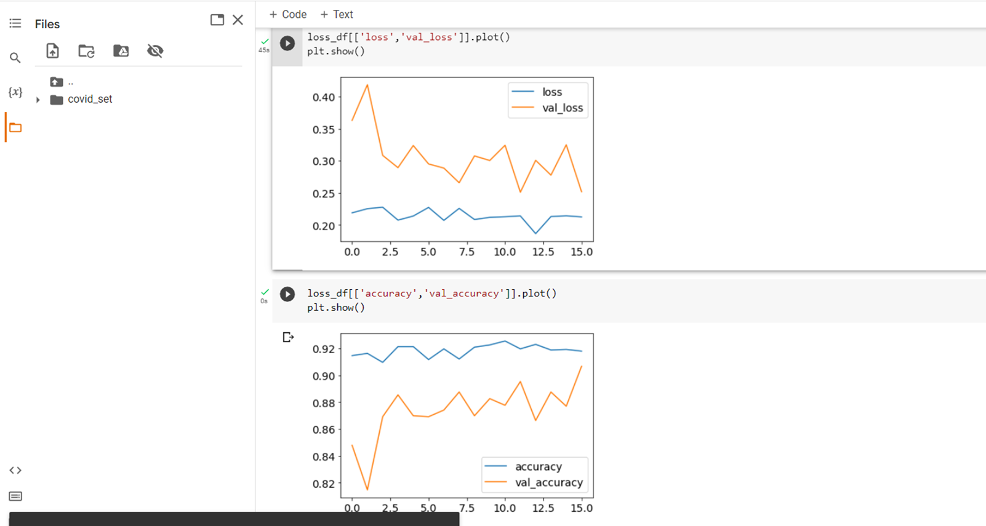
Dataset-2:
Both the loss functions and accuracy of train and test data sets is not at a large difference.

Slide 15
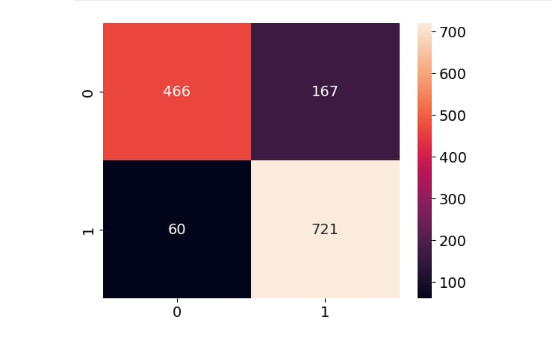
For the dataset_2 we implemented a confusion matrix to show the number of correct representation of the images of covid and normal x-rays done by our model.

Slide 16
For Dataset-1 : number of epchos used are 10.
For Dataset-2 : number of epchos used are 30.
But for Dataset-1
Call backs [early stop] is used.
So, as the accuracy and loss function are not changing much in each epoch,
they are stopped at 16.

Slide 17
CONCLUSION:
This project involves training a machine learning algorithm to predict the severity of COVID-19 pneumonia from chest X-ray images. The project can be broken down into several phases, including data collection, data preprocessing, model training, model development, and model evaluation.
Data collection involves gathering a large dataset of chest X-ray images with COVID-19 pneumonia severity labels. Data preprocessing involves cleaning and preparing the data for use in training the machine learning algorithm. Model training involves using the prepared data to train the algorithm to predict the severity of COVID-19 pneumonia on new and unseen chest X-ray images. Model development involves refining the algorithm and optimizing its performance.
Model evaluation is a critical step in assessing the performance of the machine learning algorithm. This involves testing the model's ability to accurately predict the severity of COVID-19 pneumonia on new and unseen chest X-ray images and comparing its performance to that of baseline models.
This project has the potential to be a valuable tool in diagnosing and treating COVID-19 patients. By accurately predicting the severity of COVID-19 pneumonia, healthcare professionals can provide more personalized and effective treatment to those affected by the disease.

Slide 18
References :
1. https://www.kaggle.com/datasets/raddar/tuberculosis-chest-xrays-montgomery?resource=download
2. https://www.kaggle.com/datasets/raddar/tuberculosis-chest-xrays-shenzhen
3. https://www.kaggle.com/datasets/raddar/nodules-in-chest-xrays-jsrt
4. https://www.ncbi.nlm.nih.gov/pmc/articles/PMC7451075
5. https://arxiv.org/abs/2005.11856
6. https://towardsdatascience.com/chest-x-rays-pneumonia-detection-using-convolutional-neural-network-63d6ec2d1dee

Slide 19
THANK YOU

